Slide 1
Recitation 4

Slide 2
Recitation Schedule
Problems from Chapter 1.5!

Slide 3
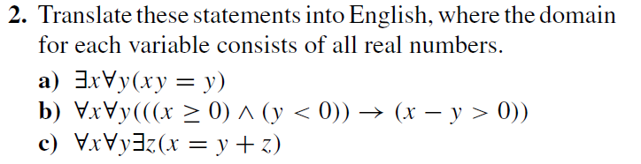
1.5 #2
Notes:
a) There exists a real number x when multiplied by all real numbers (y), the product is y
b) For all real numbers (x) and all real numbers (y), if x is 0 or positive and y is negative, then the difference of x by y is positive.
c) For all real numbers (x) and all real numbers (y), there exists a real number (z), where the sum of y and z equals x.

Slide 4
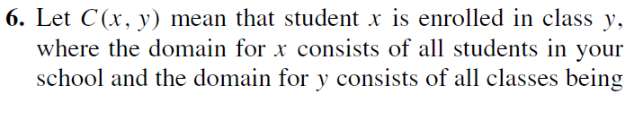
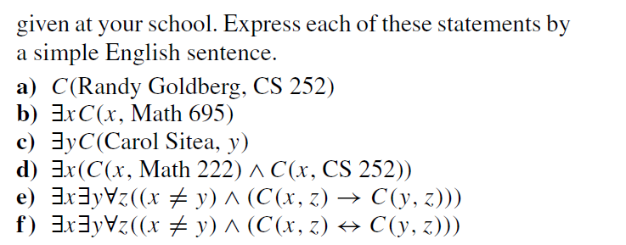
1.5 #6
Notes:
a) Randy Goldberg is enrolled in CS252.
b) There exists a student at your school enrolled in Math 695.
c) There exists a class at your school that Carol Sitea is in.
d) There exists a student at your school enrolled in Math222 and CS252
e) There exists two students x and y where student y is enrolled in all the classes student x is enrolled in.
f) There exists two students that are enrolled in all the same courses.

Slide 5
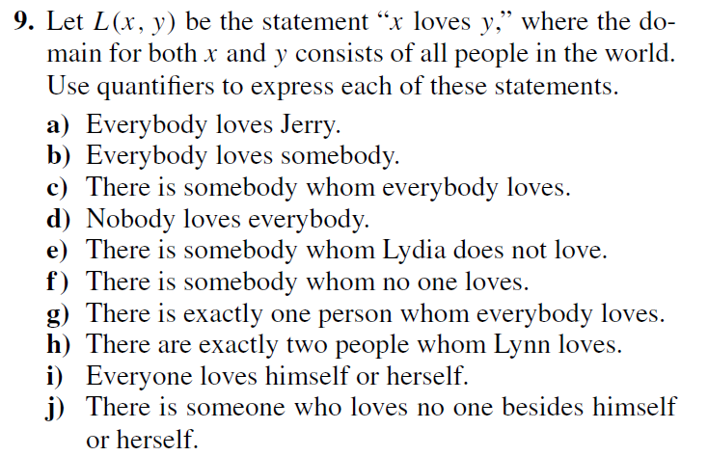
1.5 #9 a-g
Notes:
a) ∀x L(x,Jerry)
b) ∀x∃y L(x,y)
c) ∃x∀y L(x,y)
d) ∀x∃y ¬L(x,y)
e) ∃y ¬L(Lydia,y)
f) ∃y∀x ¬L(x,y)
g) ∃!x∀y L(y,x)
∃! Is the symbol meaning “there exists exactly one”
h) ∃x∃y( L(Lynn,x) ∧ L(Lynn,y) ∧ x =/= y ∧ ∀z(L(Lynn,z) → (z = x ∨ z = y)))
i) ∀x L(x,x)
j) ∃x∀y (L(x,y) ↔ x = y))

Slide 6
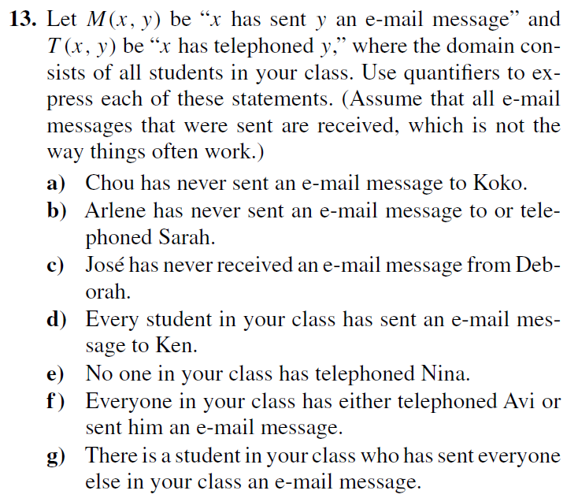
1.5 #13 a-g
Notes:
First figure out if we’re using M(x,y) or T(x,y) or both? Are we talking about emails or telephones?
a) ¬M(Chou, Koko)
b) ¬M(Arlene, Sarah) ∧ ¬T(Arlene, Sarah)
c) ¬M(Deborah, Jose)
d) ∀x M(x,Ken)
e) ∀x ¬T(x,Nina)
f) ∀x [T(x,Avi) ∨ M(x,Avi)]
g) ∃x ∀y((x=/= y → M(x,y))

Slide 7
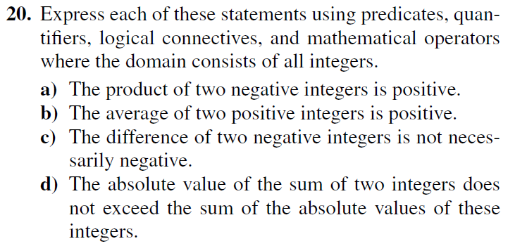
1.5 #20
Notes:
Let the domain of all variables be integers.
a) ∀x∀y[(x < 0 ∧ y < 0) → (xy > 0)]
If the domain is just negative integers then,
∀x∀y(xy > 0)
b) ∀x∀y[(x > 0 ∧ y > 0) → ((x+y)/2 > 0)]
If the domain is just positive integers then,
∀x∀y((x+y)/2 > 0)
c) ¬∀x∀y(x-y < 0)
Can also be written as: ∃x∃y¬(x-y < 0)
LOOK AT KEYWORDS
d) ∀x∀y(|x + y| ≤ |x| + |y|)

Slide 8
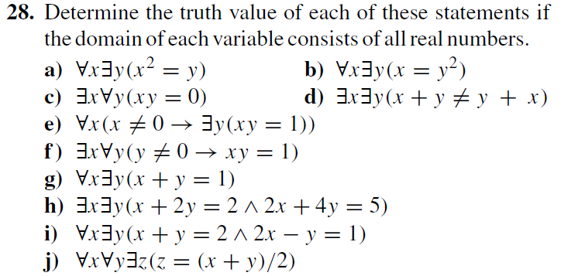
1.5 #28
Notes:
a) True
b) False
Negative numbers aren’t the square of another real number
c) True
x = 0
d) False
This goes against the commutative law
e) True
y = 1/x
f) False
If x = ½ , this statement is saying all real numbers times ½ equals 1
g) True
y = 1-x
h) False
2(x+2y = 2) -> 2x+4y=4 NOT 5
i) False
Let x = -1
x + y = 2, y = 3
2x - y = 1, y = -3
j) True

Slide 9
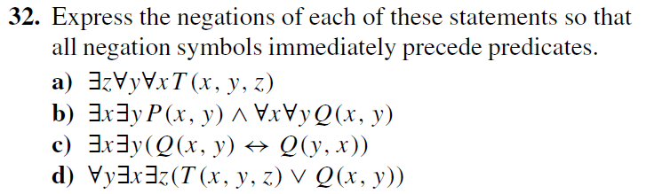
1.5 #32
Notes:
a) ∀z ∃y ∃x ¬T(x,y,z)
b) ∀x ∀y ¬P(x,y) ∨ ∃x ∃y ¬Q(x,y)
c) ∀x ∀y [(Q(x,y) ↔ ¬Q(y,x)]
∀x ∀y [¬Q(x,y) ⊕ ¬Q(y,x)]
Both answers are correct because xor is the opposite of a biconditional
Truth Table: https://docs.google.com/document/d/1ceFd_Ov_TbX_VdO_jISJ_Fq5Yr-ZELs2Ac10IwKED9Y/edit?usp=sharing
d) ∃y ∀x ∀z [¬T(x,y,z) ∧ ¬Q(x,y)]

Slide 10
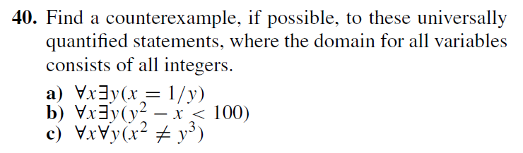
1.5 #40
Notes:
First, find if a counterexample is possible (it is not possible if the statement is a tautology)
a) For all integers (x), there exists an integer (y) where x = 1/y.
This is FALSE.
Counterexample: Let y = 0, then x = 1/0 which is not an integer
b) For all integers (x), there exists an integer (y) where y^2 - x < 100
This is FALSE.
Counterexample: Let y = 11 and x = 0, then y^2 - x = 121 - 0 = 121 > 0
c) For all integers (x) and all integers (y) x^2 =/= y^3
This is FALSE
Counterexample: Let x = y = 1, then x^2 = 1^2 = 1 and y^3 = 1^3 = 1 this x^2 = y^3
Let’s change it up a bit. Let’s have (x^2 =/= y^3 AND x =/= y)
This is FALSE
Counterexample: Let x = 8 and y = 4, then x^2 = 8^2 = 64 and y^3 = 4^3 = 64

